Slide 1
Dapr
Lecturer: Ngo Huy Bien
Software Engineering Department
Faculty of Information Technology
VNUHCM - University of Science
Ho Chi Minh City, Vietnam
nhbien@fit.hcmus.edu.vn

Slide 2

Objectives

Slide 3

Contents

Slide 4

References
Haishi Bai and Yaron Schneider (2020). Learning Dapr. O'Reilly Media.
Radoslav Gatev (2021). Introducing Distributed Application Runtime (Dapr). Apress.

Slide 5
Distributed Application Runtime

Slide 6
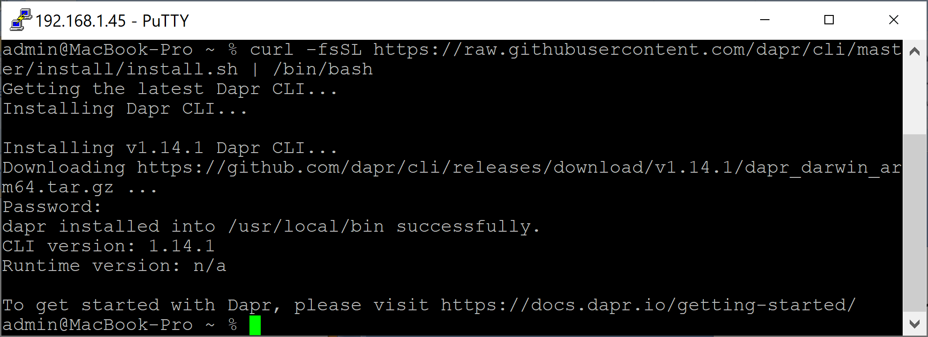
1. Install the Dapr CLI on macOS
https://docs.dapr.io/getting-started/install-dapr-cli/
curl -fsSL https://raw.githubusercontent.com/dapr/cli/master/install/install.sh | /bin/bash
dapr -h

Slide 7
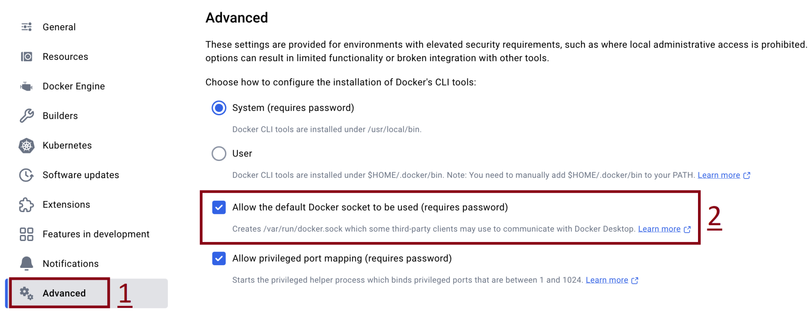
2. Allow the default Docker socket to be used

Slide 8
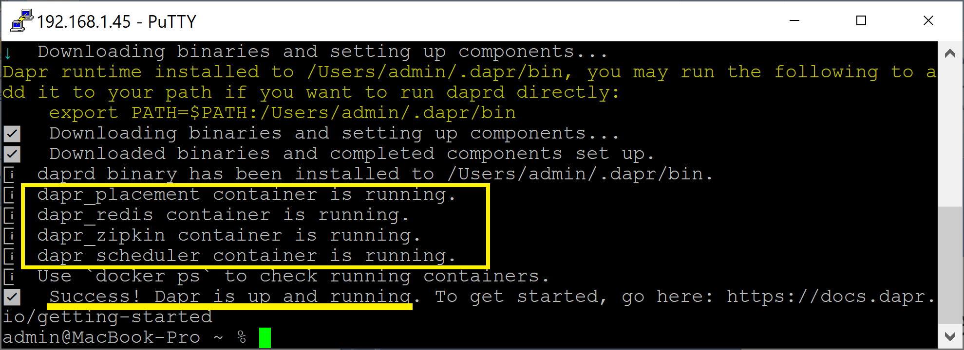
3. Initialize Dapr
dapr init

Slide 9
Dapr initialization includes:
Running a Redis container instance to be used as a local state store and message broker.
Running a Zipkin container instance for observability.
Creating a default components folder with component definitions for the above.
Running a Dapr placement service container instance for local actor support.
Running a Dapr scheduler service container instance for job scheduling.

Slide 10
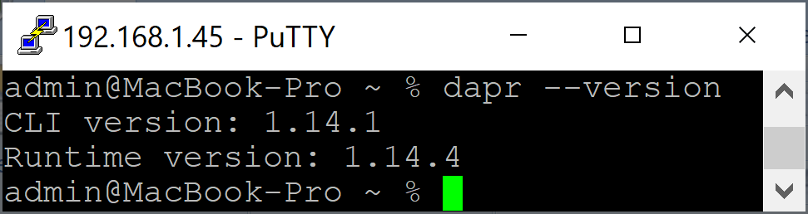
4. Verify Dapr Installation
dapr --version
docker ps
ls $HOME/.dapr

Slide 11
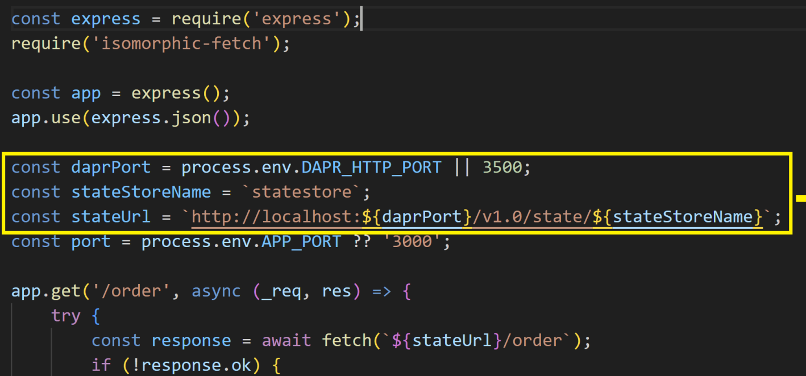
5. Review Node Hello World Code
https://github.com/dapr/quickstarts/tree/master/tutorials/hello-world
git clone https://github.com/dapr/quickstarts.git
cd quickstarts/tutorials/hello-world/node

Slide 12
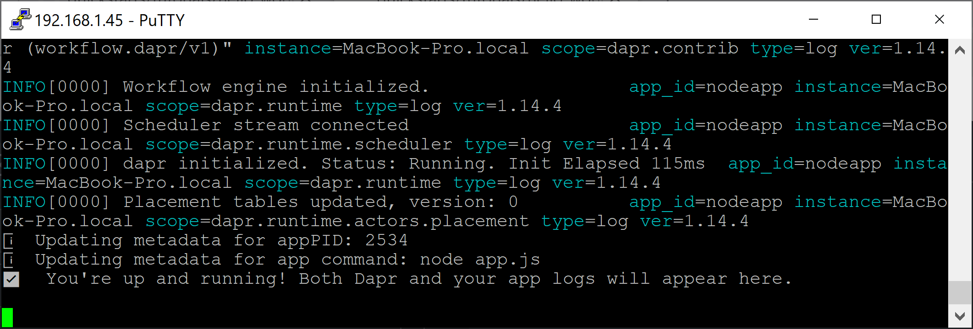
6. Run Node.js app with Dapr
npm install
dapr run --app-id nodeapp --app-port 3000 --dapr-http-port 3500 node app.js

Slide 13
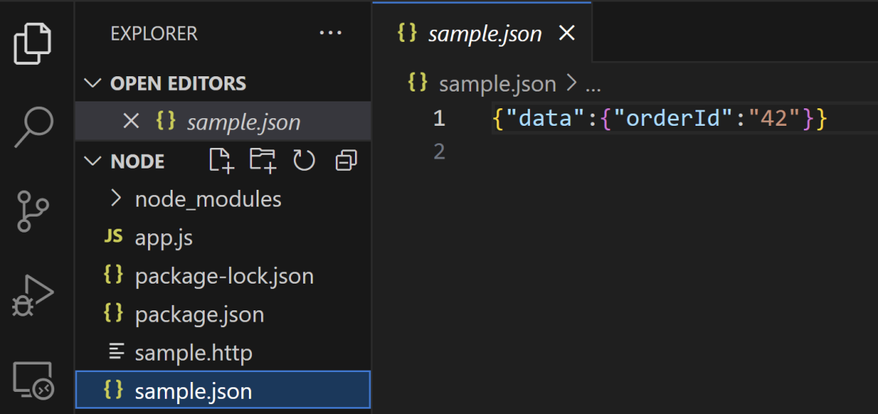
7. Post messages to the service
cd quickstarts/tutorials/hello-world/node
dapr invoke --app-id nodeapp --method neworder --data-file sample.json
dapr invoke --app-id nodeapp --method order --verb GET

Slide 14


Slide 15
What is Dapr? (I) [1]
Dapr is a an event-driven, portable runtime for building microservices for the cloud and the edge.
It uses a companion container or process to deliver the building blocks needed by distributed applications, including state management, service discovery, reliable messaging, observability.
Dapr companion processes, or sidecars, expose a standard API surface through HTTP/gRPC protocols. This allows Dapr to support any programming language that supports HTTP or gRPC without requiring any SDKs for libraries to be included in application code.
Dapr sidecars are interconnected to form an isolated, distributed runtime for a distributed application.

Slide 16
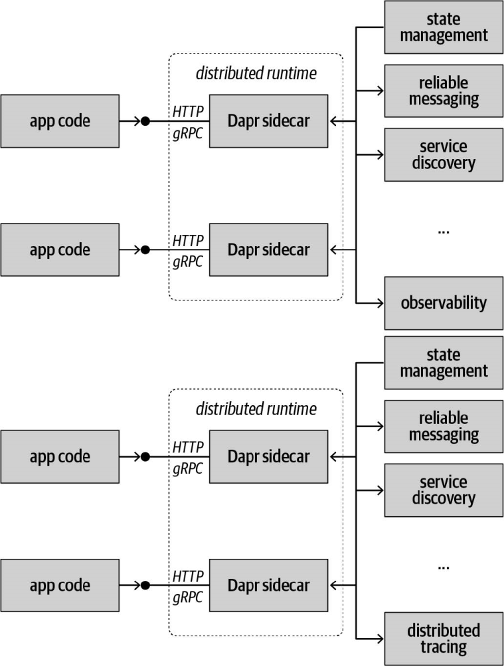
What is Dapr? (II)

Slide 17
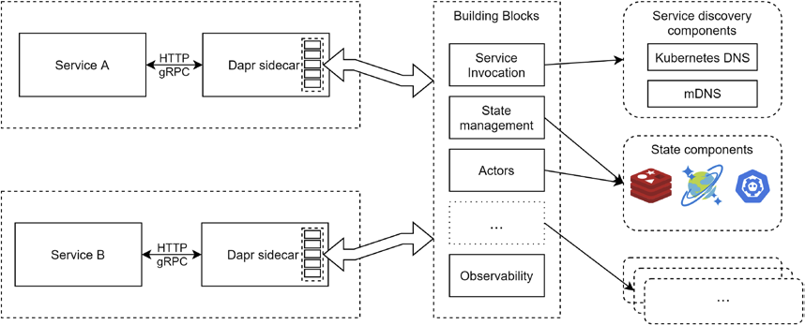
What is Dapr? (III) [2]

Slide 18
Dapr vs. Service Meshes
https://techcommunity.microsoft.com/blog/azuredevcommunityblog/decoding-the-dynamics-dapr-vs-service-meshes/4021563

Slide 20

Further Reading

Slide 21

Thank You & See You Again

